Slide 1
Search Engine Basics

Slide 2
Understanding Search Engine Results
A search engine is an online answering machine, which is used to search, understand, and organize content's result in its database based on the search query (keywords) inserted by the end-users (internet user).
The pages the engines return to fulfill a query are referred to as search engine results pages (SERPs). (The process of organizing content in the form of a list is commonly known as a Search Engine Results Page (SERP).)
Each engine returns results in a slightly different format and these may include vertical results

Slide 3
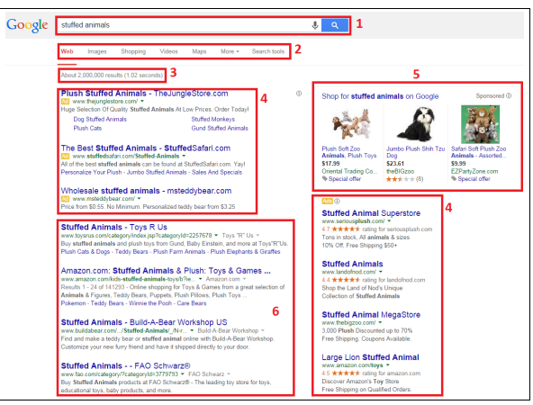
The various sections outlined in the Google search results are as follows:
1. Search query box
2. Vertical navigation
3. Results information
4. PPC Advertising
5. Google Product Search Results
6. Natural/organic/algorithmic results

Slide 4
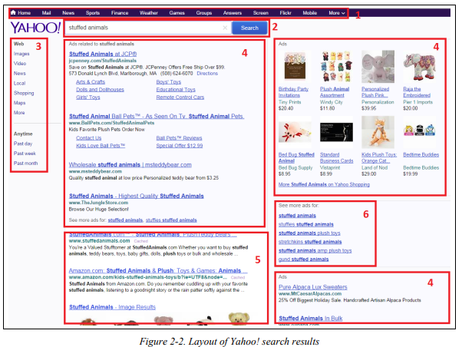
The sections in the Yahoo! results are as follows:
1. Vertical navigation
2. Search query box
3. Horizontal navigation
4. PPC Advertising
5. Natural/organic/algorithmic results
6. Navigation to More Advertising
Even though Yahoo! no longer does its own crawl of the web, or provides its own search results information (it sources them from Bing), it does format the output differently

Slide 5
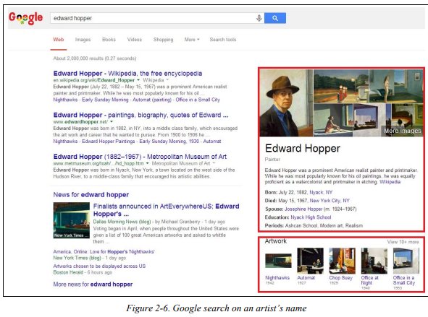
An example of a search for a well-known painter.
A Google search for the famous painter Edward Hopper returns image results of some of his most memorable works.
If the user is interested in the first painting shown, he may well click on it to see the painting in a larger size or to get more information about it.
For the SEO practitioner, getting placed in this vertical result could be a significant win.

Slide 6
Google’s Knowledge Graph
we can see that Google understands that:
Edward Hopper is the name of a person.
People have dates and place of birth
People have dates and places of death
People might have spouses
The search engines are actively mapping these types of relationships as part of their effort to offer more complete information directly in the search results themselves

Slide 7
Algorithm-Based Ranking Systems: Crawling, Indexing, and Ranking
Crawling and Indexing
To offer the best possible results, search engines must attempt to discover all the public pages on the World Wide Web and then present the ones that best match up with the user's search query.
The first step in this process is crawling the web. The search engines start with a seed set of sites that are known to be very high quality sites, and then visit the links on each page of those sites to discover other web pages
The link structure of the Web serves to bind together all of the pages that were made public as a result of someone linking to them. Through links, search engines’ automated robots, called crawlers, spiders can reach the many billions of interconnected documents.

Slide 8
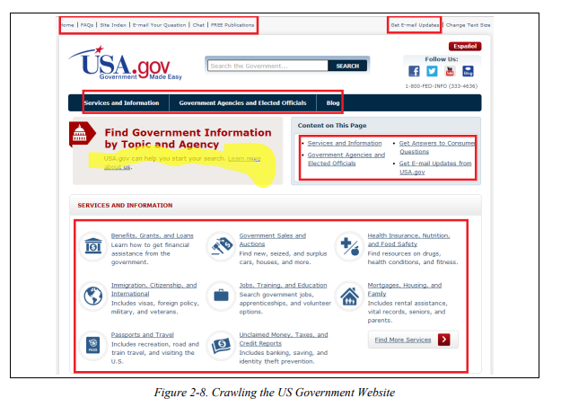
Web Crawler is also known as a search engine bot, web robot, or web spider.
It plays an essential role in search engine optimization (SEO) strategy.
It is mainly a software component that traverses on the web, then downloads and collects all the information over the Internet.

Slide 9
The search engine will then load those other pages and analyze that content as well. This process repeats over and over again until the crawling process is complete.
This process is an enormously complex one as the web is a large and complex place. Search engines do not attempt to crawl the entire web every day.
In fact they may become aware of pages that they choose not to crawl because they are not likely to be important enough to return in a search result.

Slide 10
The first step in this process is to build an index of terms.
This is a massive database that catalogs all the significant terms on each page crawled by the search engine.
A lot of other data is also recorded, such as a map of all the pages that each page links to, the clickable text of those links (we call this the anchor text), whether or not those links are considered ads, and more.
To accomplish the monumental task of holding data on hundreds of billions (or trillions) of pages that can be accessed in a fraction of a second, the search engines have constructed massive data centers to deal with all this data.

Slide 11
Retrieval and Ranking
when the search engine returns a list of relevant pages on the Web in the order most it believes is most likely to satisfy the user. This process requires the search engines to scour their corpus of hundreds of billions of documents and do two things: first,
return only the results that are related to the searcher’s query;
second, rank the results in order of perceived importance:
Relevance is the degree to which the content of the documents returned in a search matches the user’s query intention and terms. The relevance of a document increases if the page contains terms relevant to the phrase queried by the user, or if links to the page come from relevant pages and use relevant anchor text.

Slide 12
Importance refers to the relative importance, measured via citation of a given document that matches the user’s query.
The importance of a given document increases with every other document that references it.

Slide 13
Evaluating Content on a Web Page
Determining the unique content on a page is an important part of what the search engine does
Search engine crawlers and indexing programs are basically software programs. These programs are extraordinarily powerful. They crawl trillions of web pages, analyze the content of all these pages, and analyze the way all these pages link to each other.
Then they organize this into a series of databases that can respond to a user search query with a highly tuned set of results in a few tenths of a second.

Slide 14
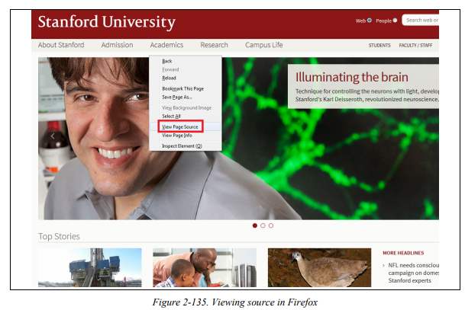
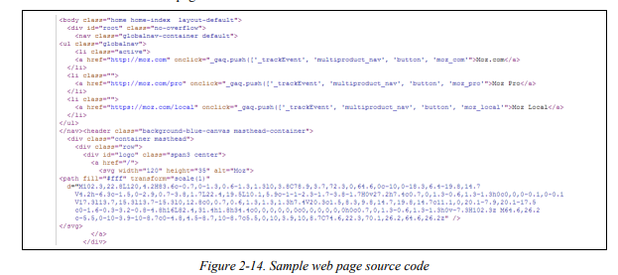

Slide 15
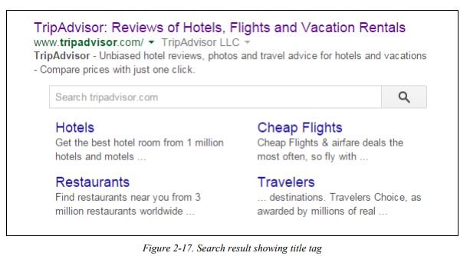
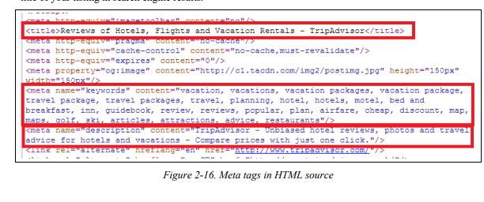

Slide 16
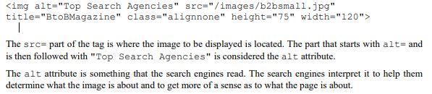
The meta description tag plays a key role as search engines often use it as a part or all of the description for your page in search results.
Therefore, a well-written meta description can have a significant influence on how many clicks you get on your search listing, and the click through rate on your search listing can impact your ranking.
A fourth element that search engines read is the alt attribute for images. The alt attribute was originally intended to allow something to be rendered when viewing of the image is not possible

Slide 17
Another element that search engines read is the noscript tag. Historically, the ability of search engines to read JavaScript was quite limited.
The noscript portion of this is Your browser does not support JavaScript.

Slide 18
What search engines cannot see
They can only recognize some very basic types of information within images, such as the presence of a face, or whether images have pornographic content by how much flesh tone there is in the image.
Content that search engines cannot see is the pictorial aspects of anything contained in Flash
Audio and video files are also not easy for search engines to read.
Search engines also cannot read any content contained within a program
One example of a technology that can present significant human-readable content that the search engines cannot see is AJAX.
AJAX is a JavaScript-based method for dynamically rendering content on a web page ,after retrieving the data from a database, without having to refresh the entire page. This is often used in tools where a visitor to a site can provide some input and the AJAX tool then retrieves and renders the correct content.

Slide 19
Determining Searcher Intent and Delivering Relevant, Fresh Content
IR scientists realized that two critical components comprised the majority of search functionality: relevance and importance
To measure these factors, search engines perform
document analysis (including semantic analysis of concepts across documents)
link (or citation) analysis.
In document analysis, search engines look at whether they find the search terms in important areas of the
document—the title, the metadata, the heading tags, and the body of the text. They also attempt to automatically measure the quality of the document based on document analysis, they also look at semantic connectivity. Semantic connectivity refers to words or phrases that are commonly associated with one another

Slide 20
Advanced SEO practitioners who seek every advantage, using semantic connectivity measurements can help in each of the following sectors:
• Measuring which keyword phrases to target
• Measuring which keyword phrases to include on a page about a certain topic
• Measuring the relationships of text on other high-ranking sites/pages
• Finding pages that provide “relevant” themed link

Slide 21
Common types of searches
Proximity searches A proximity search uses the order of the search phrase to find related documents.
For example, when you search for “sweet German mustard” you are specifying only a precise proximity match. If the
quotes are removed, the proximity of the search terms still matters to the search engine, but it will
now show documents that don’t exactly match the order of the search phrase, such as Sweet Mustard—German.
Fuzzy logic Fuzzy logic technically refers to logic that is not categorically true or false.
A common example is whether a day is sunny (is 50% cloud cover a sunny day, etc.). In search, fuzzy logic is often used for misspellings.

Slide 22
Boolean searches These are searches that use Boolean terms such as AND, OR, and NOT.
This type of logic is used to expand or restrict which documents are returned in a search.
Term weighting Term weighting refers to the importance of a particular search term to the query. The idea is to weight particular terms more heavily than others to produce superior search results.
For example, the appearance of the word the in a query will receive very little weight in selecting the results because it appears in nearly all English language documents

Slide 23
Measuring Content Quality and User Engagement
The search engines also attempt to measure the quality and uniqueness of a web site's content .They can also analyze the reading level of the document ,search engines can use to evaluate the quality of a web page is to measure actual user interaction.
Google Analytic
This provides Google with a rich array of data on that site, including:
• Bounce Rate: The percentage of visitors who visit only one page on your web site.
• Time on Site: The time spent by the user on the site.
• Page Views per Visitor: The average number of pages viewed per visitor on your site.

Slide 24
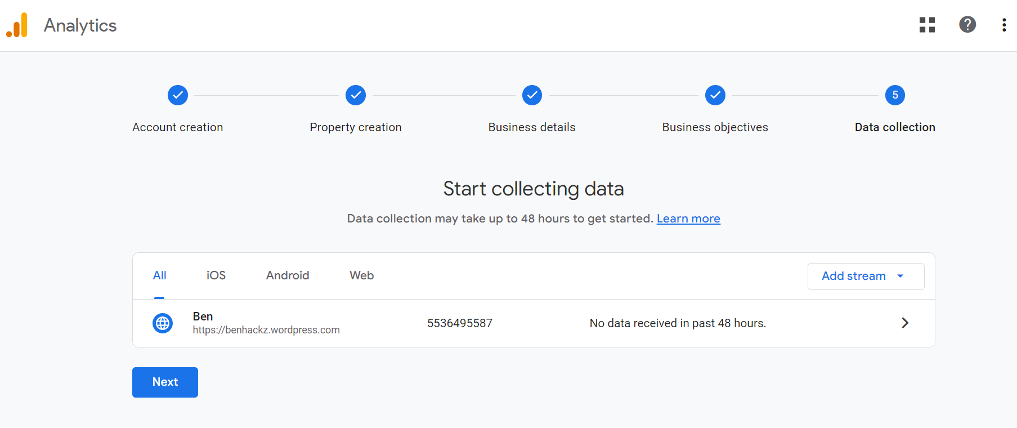

Slide 25
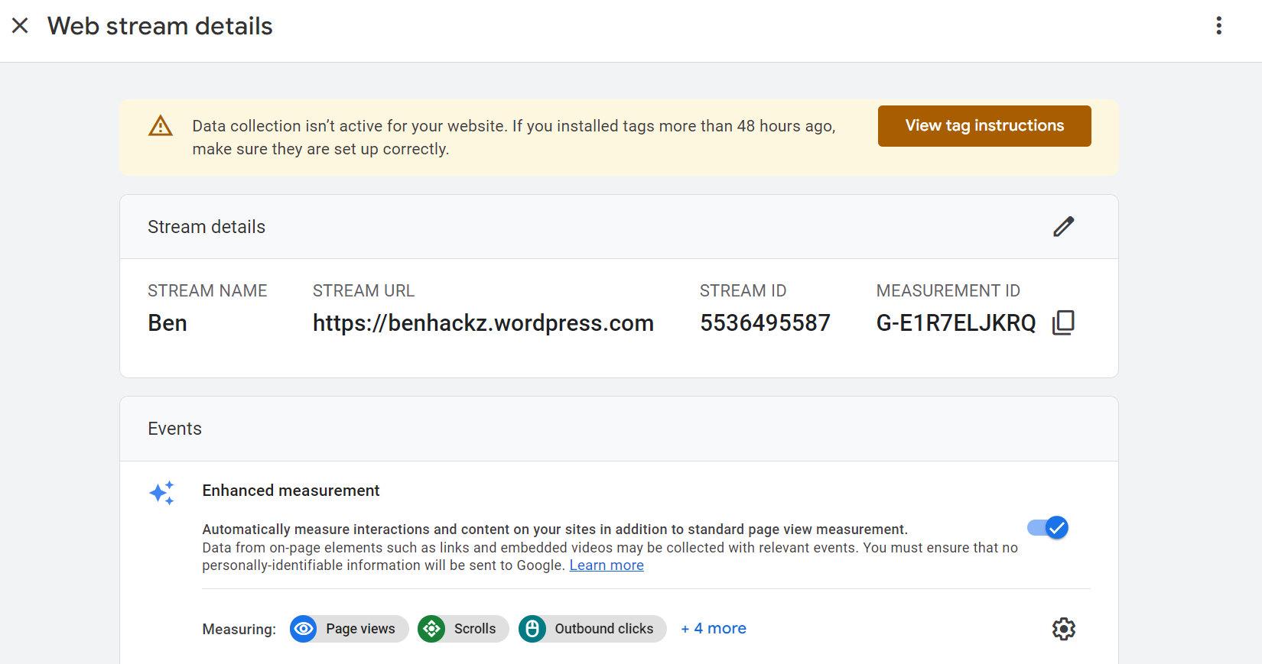

Slide 26
Google Toolbar
It is not known how many users out there use the Google Toolbar, but the authors believe that it numbers in the millions. For these users, Google can track their entire web surfing behavior. Unlike Google Analytics, the
Google Toolbar can measure the time from when a user first arrives on a site to the time when they load a page from a different web site. It can also get measurements of bounce rate and page views per visitor.
Google +1 Button
This enables users to vote for a page on the page itself. There is currently no evidence that Google uses this as a ranking factor
Goo.gl
Google has its own URL shortener. This tools allows Google to see what content is being shared, and which content is being clicked on, even in closed environments where Google web crawlers are not allowed to go.

Slide 27
Search engines deal with these types of ambiguous queries all the time. The two examples offered here have inherent problems built into them, but the problem is much bigger than that.
For example, if someone types in a query such as cars, does he:
• Want to read reviews?
• Want to go to a car show?
• Want to buy one?
• Want to read about new car technologies?
The query cars is so general that there is no real way to get to the bottom of the searcher’s intent based on this one query alone. One way that search engines deal with this is by looking at prior queries by the same searcher may provide additional clues to their intent -

Slide 28
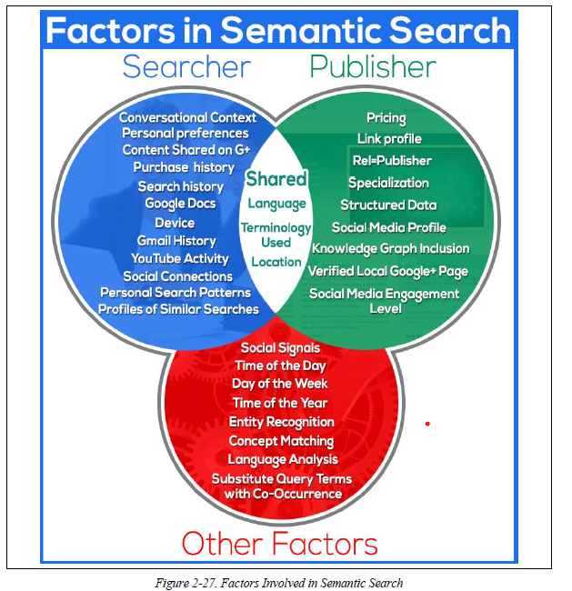

Slide 29
Analysing Ranking Factors
Domain Level Link Authority Features
Page Level Link Metrics
Page Level Keyword & Content Based
Page Level Keyword Agnostic Features
Domain Level Brand Metrics
Usage & Traffic/Query Data
Page Level Social Metrics
Domain Level Keyword Usage
Domain Level Keyword Agnostic Features

Slide 30
Domain Level Link Authority Features
Domain Level Link Authority is based on a cumulative link analysis of all the links to the domain. This includes factors such as the number of different domains linking to the site, the trust/authority of those domains, rate at which new inbound links are added, the relevance of the linking domains, and more.
Page Level Link Metrics
This refers to the links as related to the specific page, such as the number of links, the relevance of the links, and the trust and authority of the links received by the page.
Page Level Keywords & Content
This describes use of the keyword term/phrase in particular parts of the HTML code on the page (title element, H1s, alt attributes, etc.).
Page Level Features Other than Keywords
Factors included here are on page elements such as number of links on the page, number of internal links, number of followed links, number of “NoFollow” links, and other similar factors.

Slide 31
Domain Level Brand Metrics
This factor includes search volume on the web site's brand name, mentions, whether they have a presence in social media and other brand related metrics.
Page Level Traffic/Query Data
Elements of this factor are Click Through Rate (CTR) to the page in the search results, bounce rate of visitors to the page, and other similar measurements.
Page Level Social Metrics
Social metrics considered include mentions, links, shares, Likes and other social media site based metrics.
Domain Level Keyword Usage
This refers to how keywords are used in the root or subdomain name, and how impactful that might be on search engine rankings.
Domain Level Keyword Agnostic Features
Major elements of this factor in the survey included number of hyphens in the domain name, number characters in the domain name, and domain name length.

Slide 32
Negative Ranking Factors
Malware being hosted on the site
The search engines will act rapidly to penalize sites that contain viruses or trojans.
Cloaking
Search engines want publishers to show the same content to the search engine as is shown to users.
Pages on the sites with links for sale
Google has a strong policy against paid links.(http://www.google.com/support/webmasters/bin/answer.py?answer=66736), and sites that sell links may be penalized.
Content which advertises paid links on the site
As an extension of the prior negative ranking factor, promoting the sale of paid links may be a negative ranking factor.
Page Speed
Back in 2010, Google’s Matt Cutts announced that Google was making Page Speed a ranking factor (https://www.mattcutts.com/blog/site-speed/). In general, it is believed that it is a negative factor for pages that are exceptionally slow.

Slide 33
Other Ranking Factors
Rate of acquisition of links
User data
Personalization is one of the most talked about frontiers in search.

Slide 34
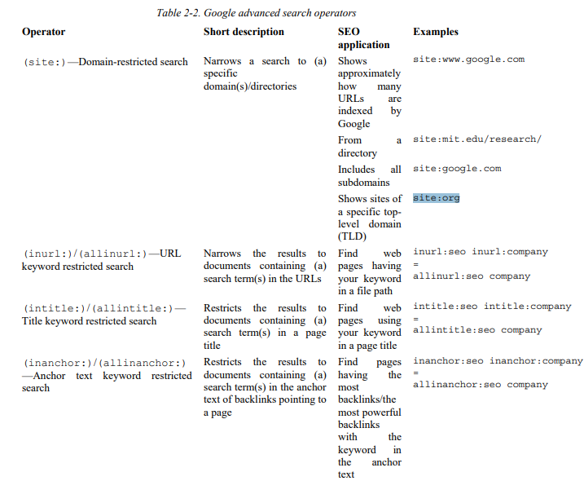
Using Advanced Search Techniques

Slide 35
https://searchengineland.com/advanced-google-search-operators-388355

Slide 36
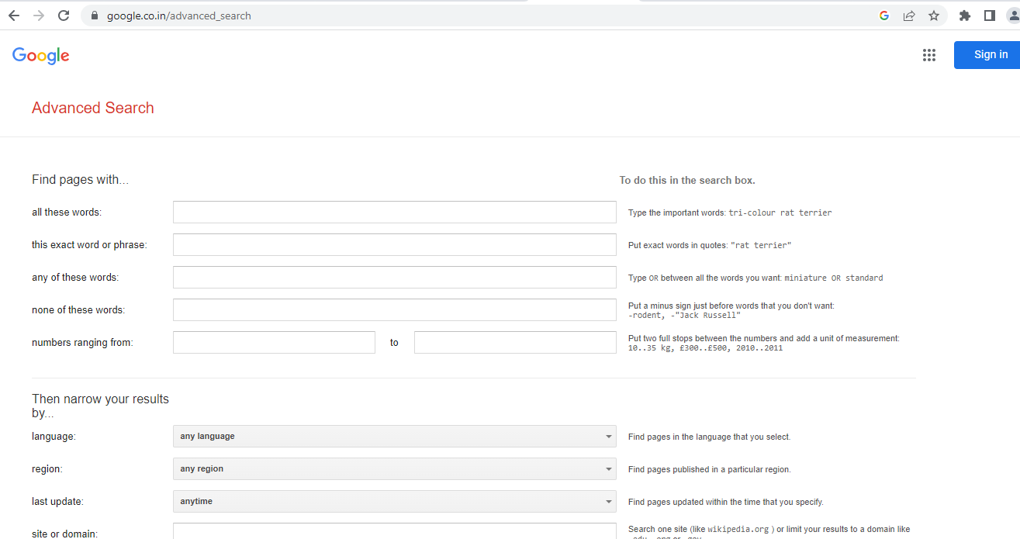

Slide 37
Vertical search is the term people sometimes use for specialty or niche search engines that focus on a limited data set.
Examples of vertical search solutions provided by the major search engines are image, video, news, and blog searches.
Vertical search engines sometimes come in the form of specialty web sites, such as travel sites (such as TripAdvisor, http://www.tripadvisor.com),
and local business listing sites (such as YellowPages.com, http://www.yellowpages.com).
Any site, such as these, that focus on vertically oriented niche markets could be considered a vertical search engine.

Slide 38
Vertical Search from the Major Search Engines
The big three search engines offer a wide variety of vertical search products. Here is a partial list:
Google
Google Maps, Google Images, Google Shopping, Google Blog Search, Google Video, Google News, Google Custom Search Engine, Google Book Search, etc.
Yahoo!
Yahoo! News, Yahoo! Local, Yahoo! Images, Yahoo! Video, Yahoo! Shopping, Yahoo! Autos, etc.
Bing
Bing Images, Bing Videos, Bing News, Bing Maps, etc.

Slide 39
A very large number of searches are also performed in video search engines. YouTube (http://www.youtube.com) is the dominant video search engine
News search engines must be able to retrieve information in real time and provide near instantaneous responses. Modern consumers tend to want their news information now.
Local search/maps
Blog search Google has implemented a search engine focused just on blog search called Google Blog Search

Slide 40
Book search :The major search engines also offer a number of specialized offerings. One highly vertical search engine is Google Book Search

Slide 41
More specialized vertical search engines .Vertical search can also come from third parties.
Here are some examples:
• Comparison shopping engines, such as PriceGrabber, Shopzilla, and Nextag
• Travel search engines, such as Expedia, Travelocity, and Kayak
• Real estate search engines, such as Trulia and Zillow
• Job search engines, such as Indeed, CareerBuilder, and SimplyHired
• Music search engines, such as iTunes Music Store
• B2B search engines, such as KnowledgeStorm and ThomasNet

Slide 42
Country-Specific Search Engines
China
China Internet Watch (http://www.chinainternetwatch.com/category/search-engine/) reported in September 2014 that Baidu had about 70% market share. Information Center (http://www.cnnic.net.cn/).
Russia
According to figures announced by Yandex, the company’s market share in Russia comprised about 62% of all searches in April 2014
South Korea
Naver (http://www.naver.com) was estimated to have about 70% market share in South Korea
Czech Republic
The Startup Yard blog reported in January 2014 that Seznam (http://seznam.cz) was reported to have
more than 60% market share in Czechoslovakia

Slide 43
Optimizing for Specific Countries
Here are a few of the top factors that contribute to international ranking success:
• Owning the proper domain extension (e.g., .com.au, .uk, .fr, .de, .nl) for the country that your business
is targeting
• Hosting your website in the country you are targeting (with a country-specific IP address)
• Registering with local search engines:
• Google My Business: https://www.google.com/business/
• Yahoo Small Business: https://smallbusiness.yahoo.com/
• Bing Places: https://www.bingplaces.com/
• Having other sites from the same country link to you
• Using the native language on the site (an absolute requirement for usability)

Slide 44
• Help Google serve the correct language or regional URL in the search results by adding hreflang attribute (https://support.google.com/webmasters/answer/189077?hl=en).
• Placing your relevant local address data on major pages of the site
• Set your geographic target in Google Webmaster Tools
(you can read more about this here:
https://support.google.com/webmasters/answer/62399).
Note that Google does not really need you to do this if your site is on a ccTLD such as “.de” or “.co.uk” as the preferred regional target is assumed.

Slide 45
https://developers.google.com/search/docs/essentials/spam-policies?hl=en&visit_id=638228704077654656-155778658&rd=2#cloaking
https://developers.google.com/search/docs/fundamentals/get-on-google

